Slide 1




Multiphonon theory of electronic transitions at defects in semiconductors – carrier capture and H Release
Laura Nichols
November 2024
Committee
Collaborators (Vanderbilt)
Collaborators (Florida)
Sokrates Pantelides (advisor), VU
Andrew O’Hara
Xiaoguang Zhang (co-advisor)
Xiaoguang Zhang (co-advisor), UF
Schrimpf-Fleetwood-Reed Radiation
Effects and Reliability Group
Guanzhi Li (graduate student)
Kalman Varga, VU
William Perry (graduate student)
Sait Umar, VU
Collaborators (UT Dallas)
Yue Yu (former student)
Ron Schrimpf, VU
Max Fischetti
Dallin Nielsen (post-doc)

Slide 2
Background

Slide 3
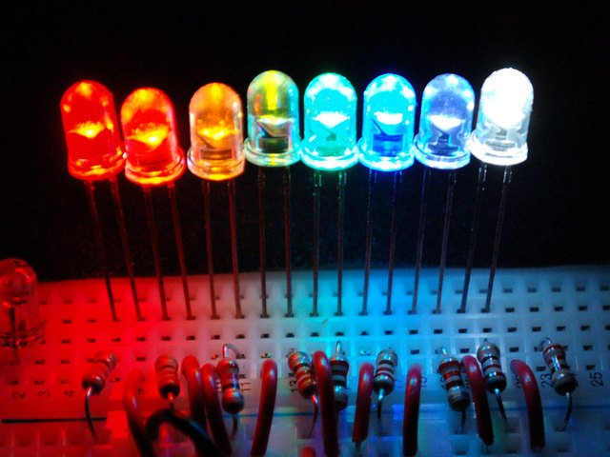
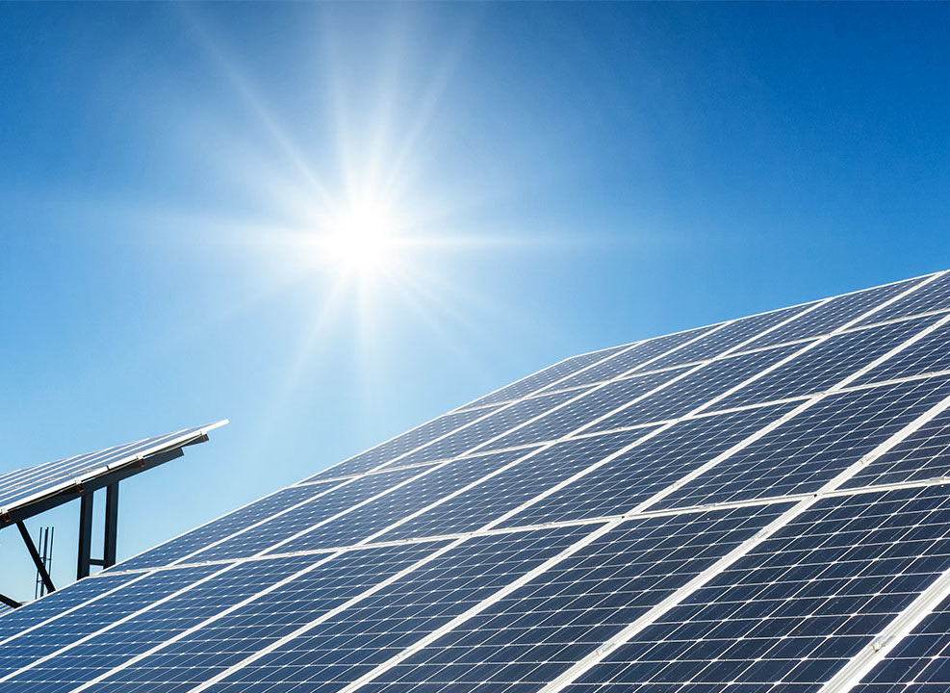

Semiconductor applications

Slide 4
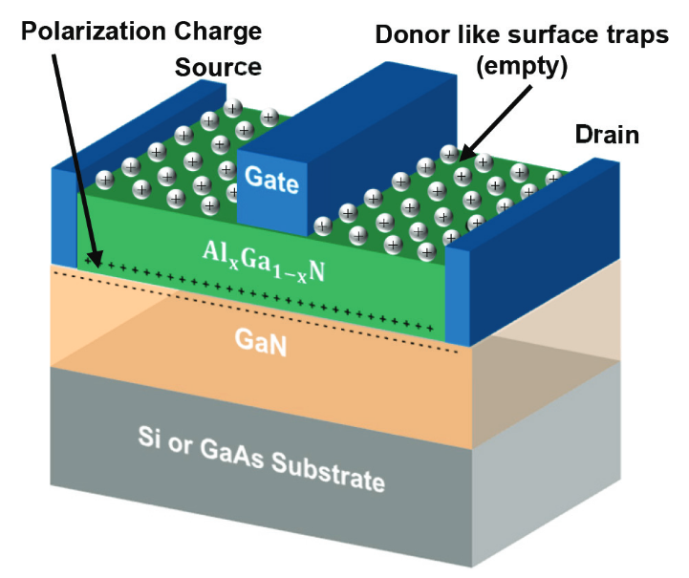
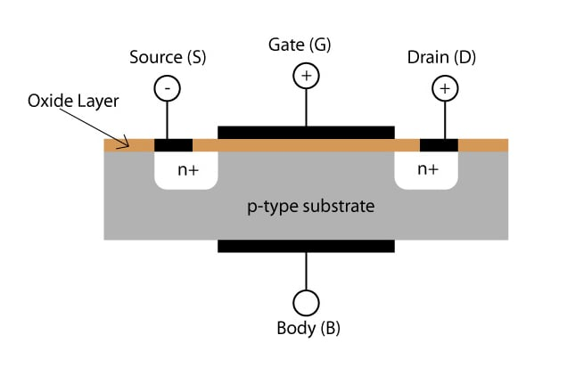
Si MOSFET vs GaN HEMT
M. N. A. Aadit et al., InTech (2017)
Notes:
MOSFET set up through junctions between differently-doped Si
HEMTs, however use a junction between materials of different band gaps to set up a conduction channel without dopants that can scatter carriers
HEMTs are also made from material with a larger band gap, which makes them more suitable for high-temperature/high-power applications
Si-based MOSFETs are primarily used now because Si can be made very cleanly made relatively cheaply compared to other semiconductor devices
The production process can be tuned to avoid certain defects, but we need more information on which defects cause the most degradation

Slide 5
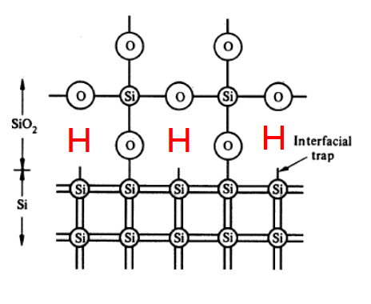
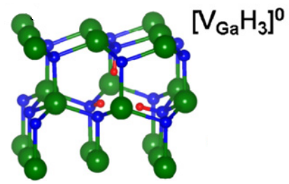
Effect of Defects
Notes:
In both devices, H is present during the fabrication process and passivates defects

Slide 6
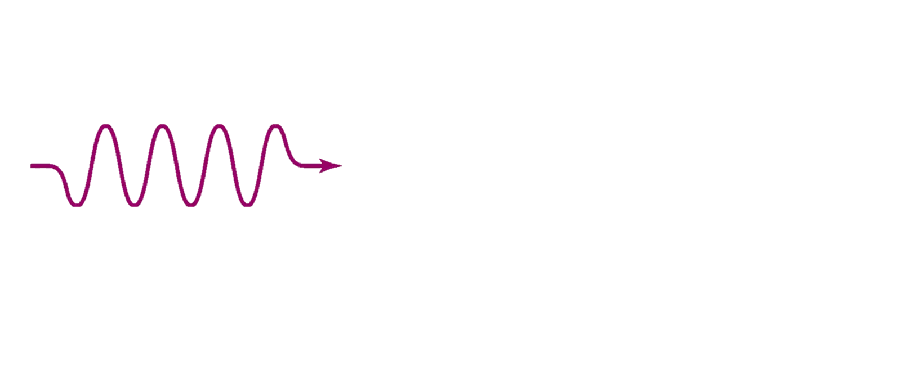
Radiative Capture
Capture
Conduction band
e
ΔE
Energy
Valence band
Notes:
Base of the theory is based on Fermi’s golden rule that gives the probability of transition between two states
That theory must be expanded to cover both the electronic and the vibrational state because we consider nonradiative transitions and energy must be conserved
We use the Born-Oppenheimer approximation that says that the electronic transition happens much quicker than the atoms move so that they can be considered to be stationary during the transition
FGR and BOA are well-known. We start with the specific case of capture, where there is a single final state and a well-defined change in the equilibrium positions before and after displacement. Seems straightforward.

Slide 7
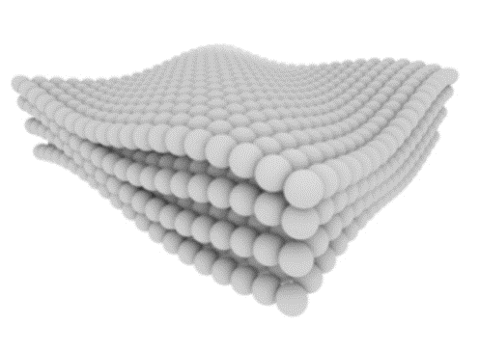
Nonradiative Scattering
Scattering
Conduction band
e
ΔE
Energy
Valence band
Public Domain; Sean Kelley via NIST

Slide 8

Nonradiative Scattering
Scattering
Conduction band
e
ΔE
Energy
Valence band
Public Domain; Sean Kelley via NIST

Slide 9
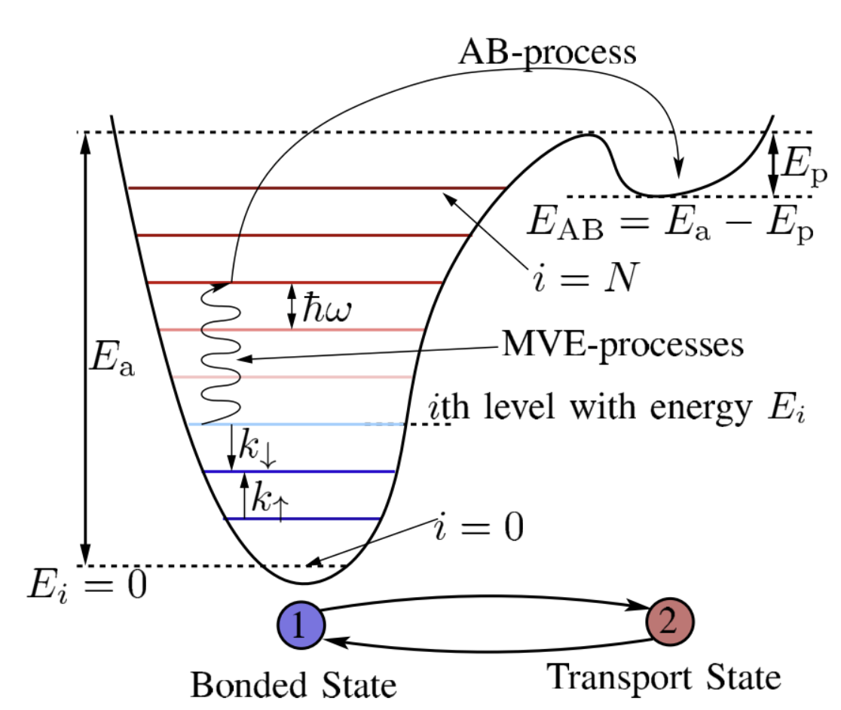
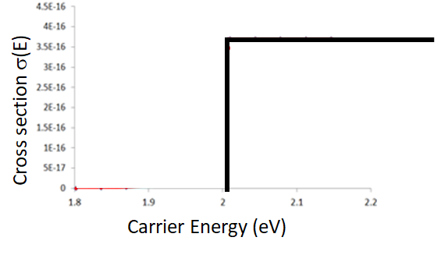
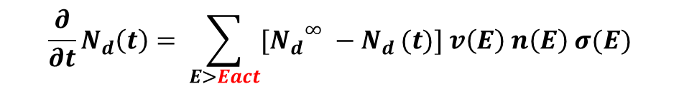
Engineering-Level Models
$$\frac{∂}{∂t}N_{d}\left(t\right)= \sum_{E>Eact}{{{[N}_{d}}^{∞} −N_{d }(t)] v\left(E\right) n\left(E\right) σ(E)}$$
Y. Puzyrev et al., IEE Trans. Elec. Dev. (2014)
M. Bina et al., IEE Trans. Elec. Dev. (2014)
Notes:
Focused on defects in semiconductors like dangling bonds and Ga vacancies
Hydrogenated during fabrication to make benign
Can be activated through hydrogen release

Slide 10
Energy Transfer via Scattering and Capture
Inelastic Scattering
Capture
Conduction band
e
Conduction band
e
ΔE
ΔE
Energy
Energy
Valence band
Valence band
Notes:
Base of the theory is based on Fermi’s golden rule that gives the probability of transition between two states
That theory must be expanded to cover both the electronic and the vibrational state because we consider nonradiative transitions and energy must be conserved
We use the Born-Oppenheimer approximation that says that the electronic transition happens much quicker than the atoms move so that they can be considered to be stationary during the transition
FGR and BOA are well-known. We start with the specific case of capture, where there is a single final state and a well-defined change in the equilibrium positions before and after displacement. Seems straightforward.

Slide 11
Nonradiative capture

Slide 12
Problem complexity
Converge usual parameters and wave function overlaps
Must determine best atomic positions to calculate overlaps at
Results can be very sensitive to energy dissipated into phonons
Calculations scale as $O(N_{A}^{4}×N_{k})$

Slide 13
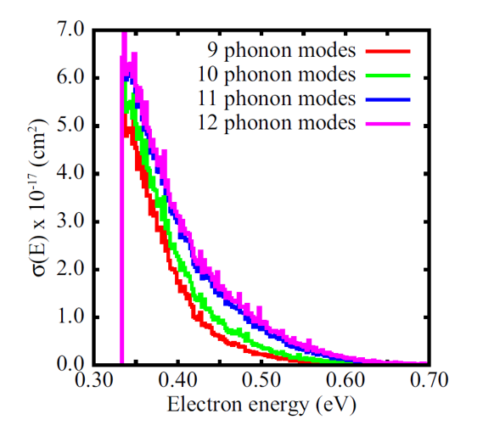
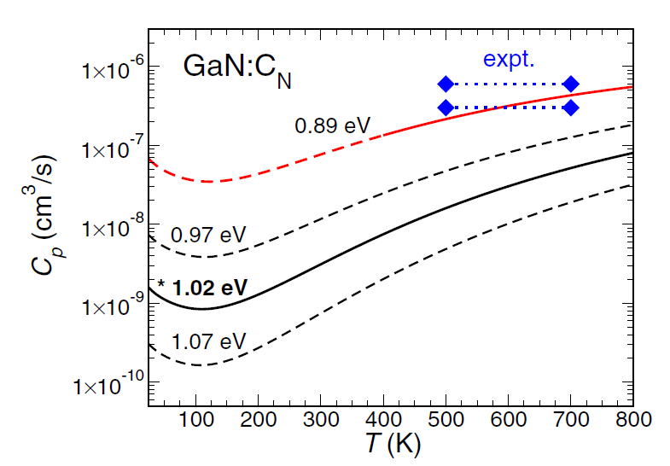
Previous Approximations
A. Alkauskas et al., Phys. Rev. B (2014)
G. Barmparis et al., Phys. Rev. B (2015)
Notes:
Alkauskas et al. allowed the frequency to change between modes, but they approximated the initial and final states each to a single average mode dominated by the defect vibrations
Barmparis et al. allowed all modes to participate, but they assumed that the initial and final frequencies were the same, had to sample the modes allowed to participate at a time, and couldn’t compute the electron-phonon coupling term

Slide 14
Example Timing of All Modes and Optimization
4x4x4, 512-atom Si supercell
VASP DFT: 25 node-minute SCF per k-point ($∼$linear scaling with nodes)
8 node minutes per k-point ($∼$linear scaling with nodes)
Code to get transition rate:
1.25 node hours per k-point (not fully parallelized)
Time to get wave function derivatives:
$\left(\frac{0.5}{2}+1.25\right)×\left(3×512−3\right)/4=24$ days, $\sim 2700$ node hours
$\left(\frac{0.5}{2}+\frac{0.13}{2}\right)×\left(3×512−3\right)/4=5$ days, $\sim 966$ node hours
Notes:
Can’t utilize symmetry with the defects we consider
DFT calculations scale as O(N^3)
When considering all modes, we have to calculate wave function derivatives for each mode, scaling with O(N)
Supercell must be roughly cubic, so increasing supercell size scales number of atoms cubically

Slide 15
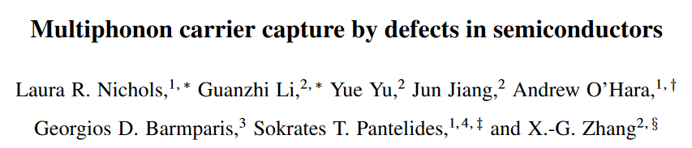
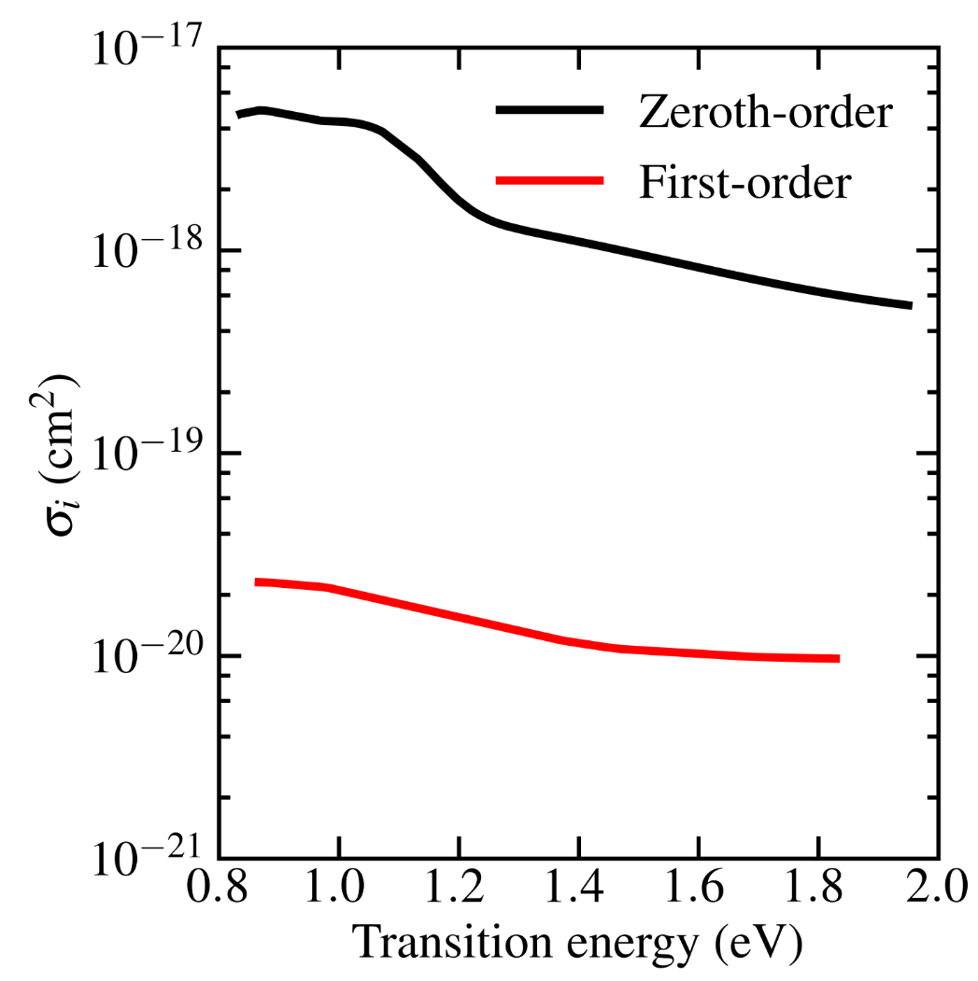
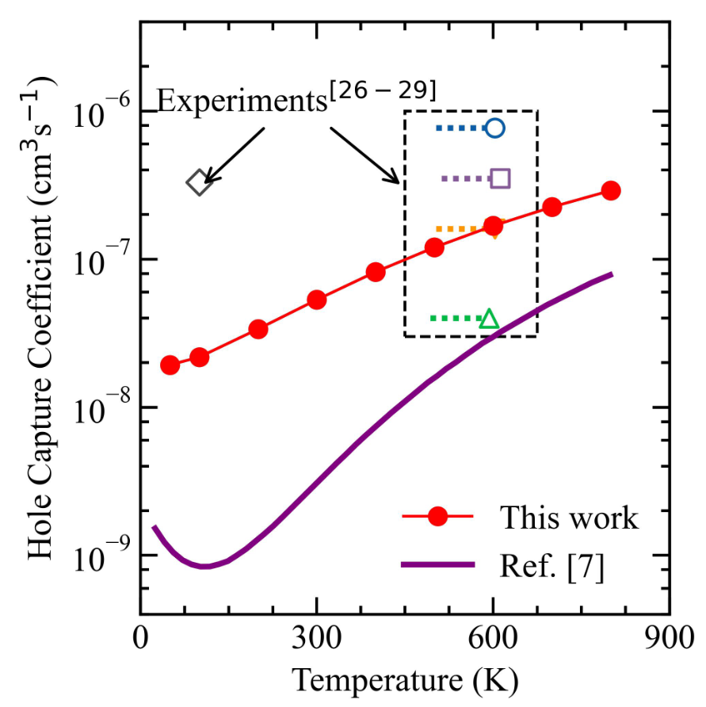
Capture paper under review
Nonequilibrium
Equilibrium
V_{Si}-H₃
GaN-C_{N}
Notes:
Box represents multiple samples
They reported data for all of the samples in one paper, but not enough for us to reconstruct what we have on the plot, so we had to go to different papers to compile the information we needed
More experiments are needed

Slide 16
H Release Theory

Slide 17

Energy Transfer via Capture and Scattering
Capture
Inelastic Scattering
e
e
ΔE
ΔE
E_{c}
E_{c}
E_{v}
E_{v}
Notes:
With the nonequilibrium capture theory created and illustrated, we can generalize to scattering
Key parameter needed for our theory is a displacement between the initial and final equilibrium positions that can be projected onto the phonon eigenvectors
It is commonly thought that there is no displacement for band-to-band scattering
In capture, only a single displacement due to the change in the charge state of the defect is considered; differences between the band states are neglected

Slide 18
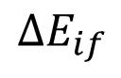
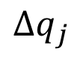
Capture vs Scattering
Capture
Inelastic Scattering
Total Energy
Total Energy
$$ΔE_{if}$$
$$Δq_{j}$$
Generalized coordinate
Generalized coordinate

Slide 19
Capture vs Scattering
Capture
Inelastic Scattering
Total Energy
Total Energy
$$ΔE_{if}$$
$$Δq_{j}$$
Generalized coordinate
Generalized coordinate

Slide 20
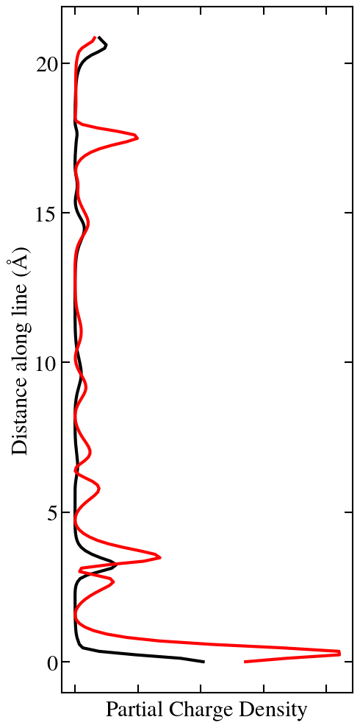
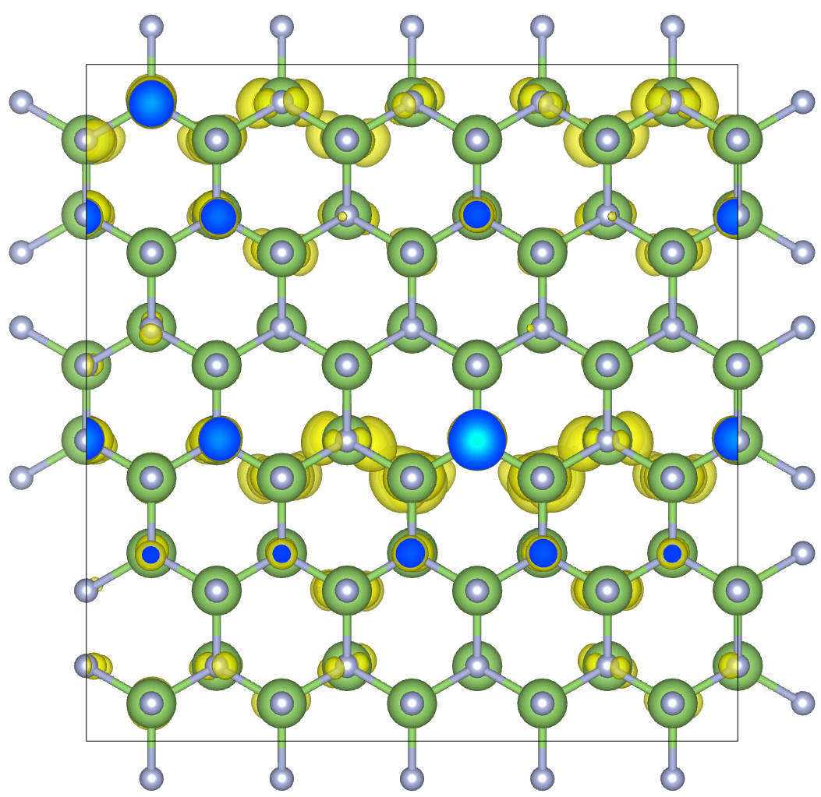
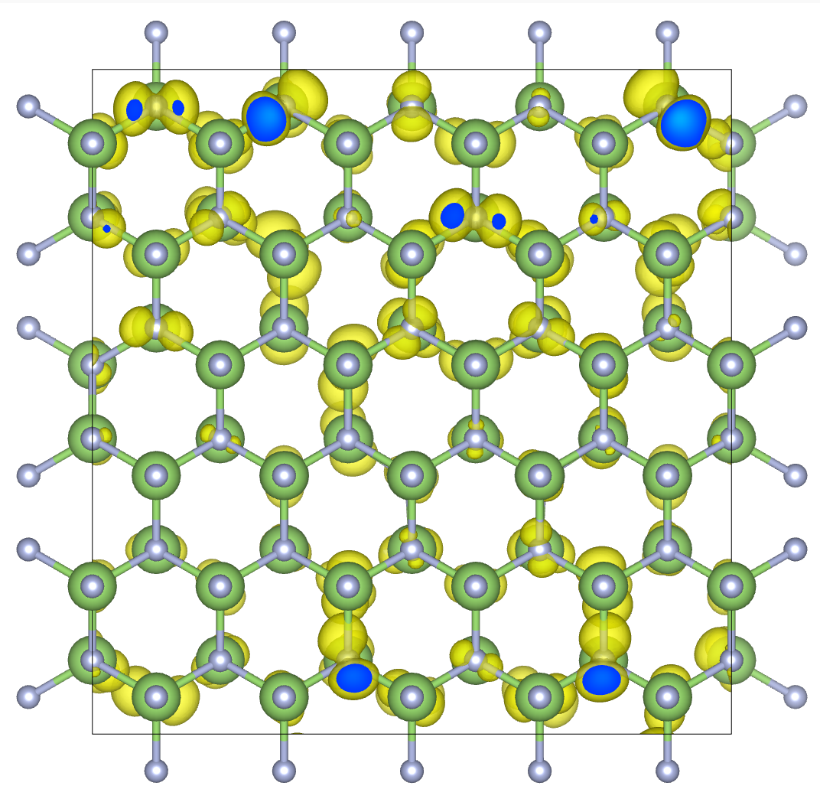
Change in Charge Density Distribution

Slide 21
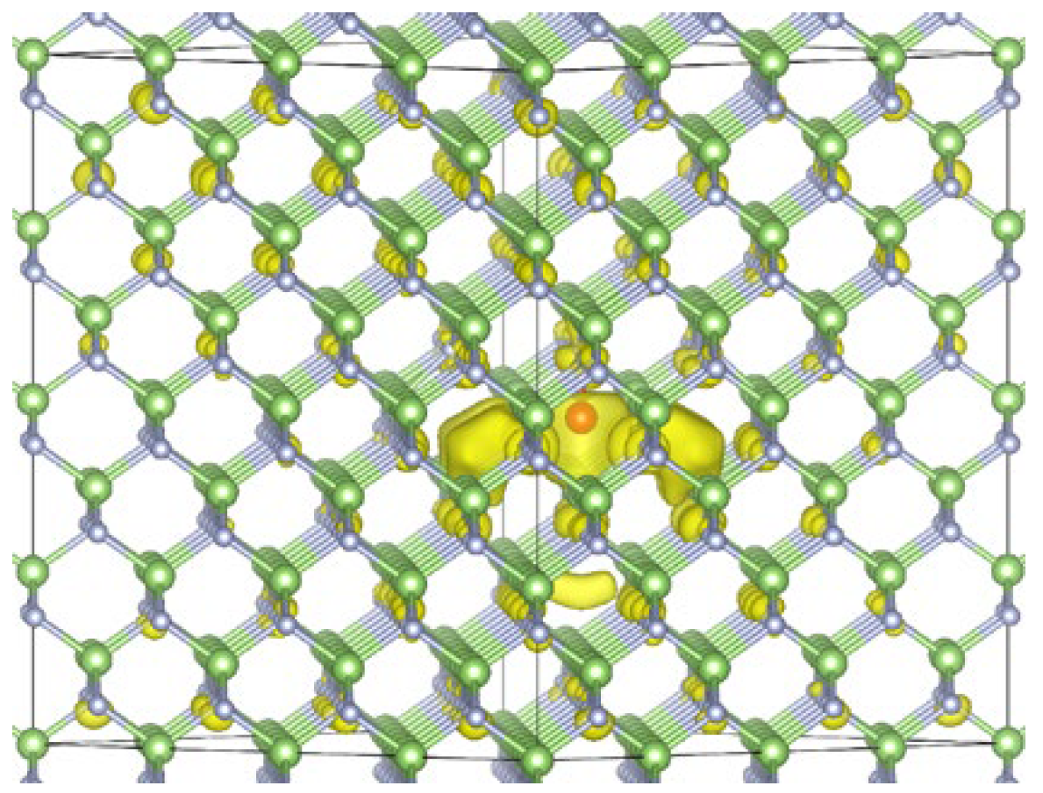
Resonance States
Antibonding
E_{c}
E_{v}
Bonding
A. O’Hara et al., Preprint (2024)
Notes:
Resonances like the bond and antibonding states could also contribute
These resonances have to be searched for

Slide 22
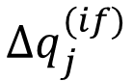

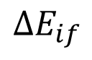
H Release Algorithm
Split across modes
Inelastic Scattering
e
Average over final states using FGR
$$ΔE_{if}$$
$$Δq_{j}^{(if)}$$
Average over initial states using $n(E)$
E_{c}
Get average rate of energy transfer to each mode
E_{v}
Step in time to get new occupations

Slide 23
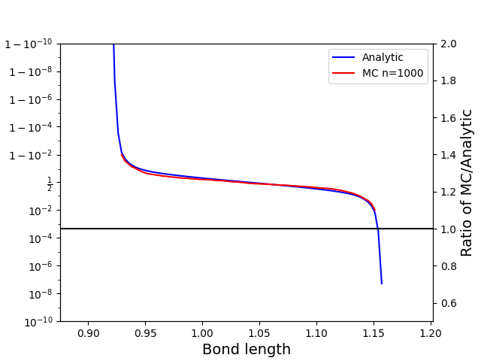


Rogue Waves
Rare large displacements may contain much of the probability of an event.
Approximations good for typical configurations may miss this contribution.
Exceedance Probabilities
Rogue-Waves
Monte Carlo
Vs.
Slide from W. Perry and X.G. Zhang, UFL

Slide 24
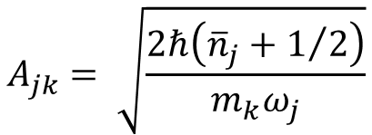
$$A_{jk}= \sqrt{\frac{2ℏ\left({\overline{n}}_{j}+1/2\right)}{m_{k}ω_{j}}}$$
Exceedance Probabilities

Slide 25
$$A_{jk}= \sqrt{\frac{2ℏ\left({\overline{n}}_{j}+1/2\right)}{m_{k}ω_{j}}}$$
Exceedance Probabilities

Slide 26
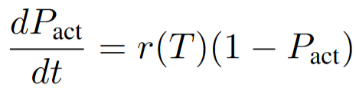
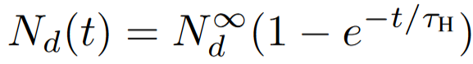
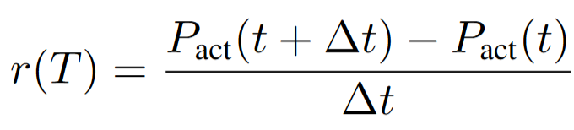
$$A_{jk}= \sqrt{\frac{2ℏ\left({\overline{n}}_{j}+1/2\right)}{m_{k}ω_{j}}}$$
Assume constant temperature
Exceedance Probabilities
Get rate from change in probability

Slide 27
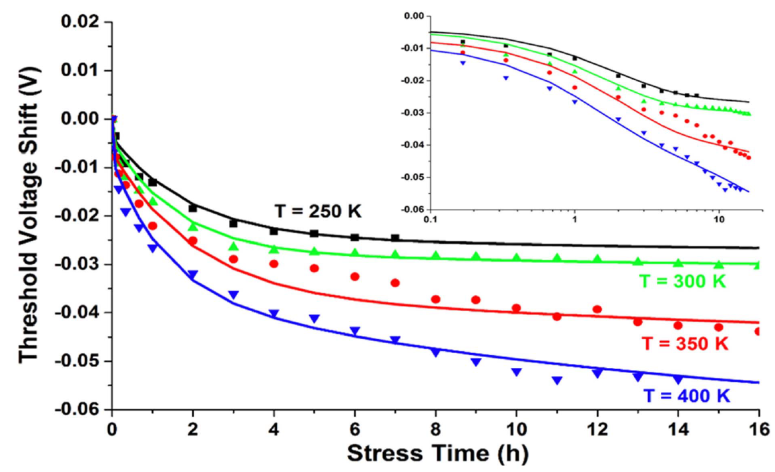
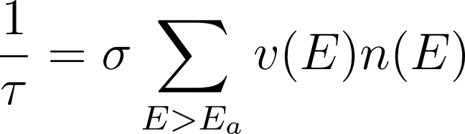
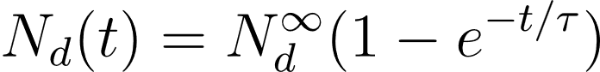
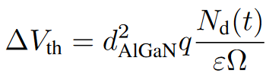
Connection to Experiments
New algorithm
S. Mukherjee et al., IEE Trans. Elec. Dev. (2016)

Slide 28
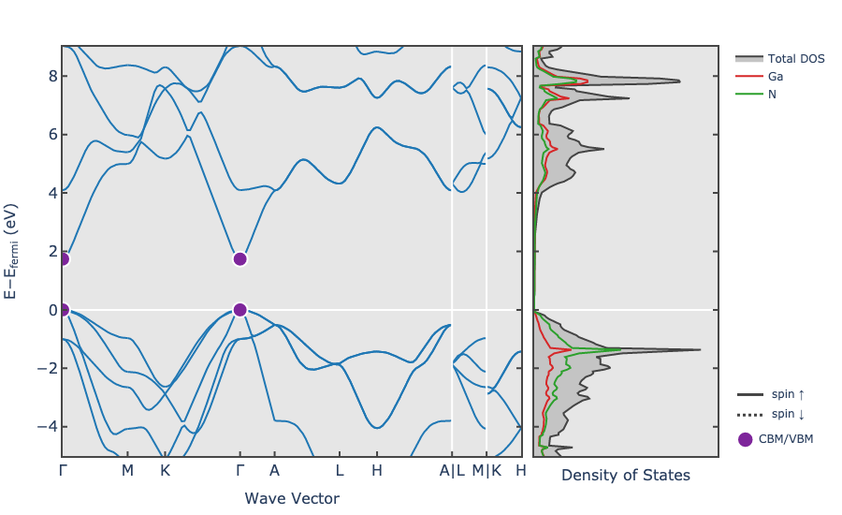
Search for Model Defect
Amorphous SiO₂ increases computational cost
Conduction bands in GaN require many k-points
N_{Ga} antisite defect complex formations
O_{N}:H metastable configuration
Plot from Materials Project

Slide 29
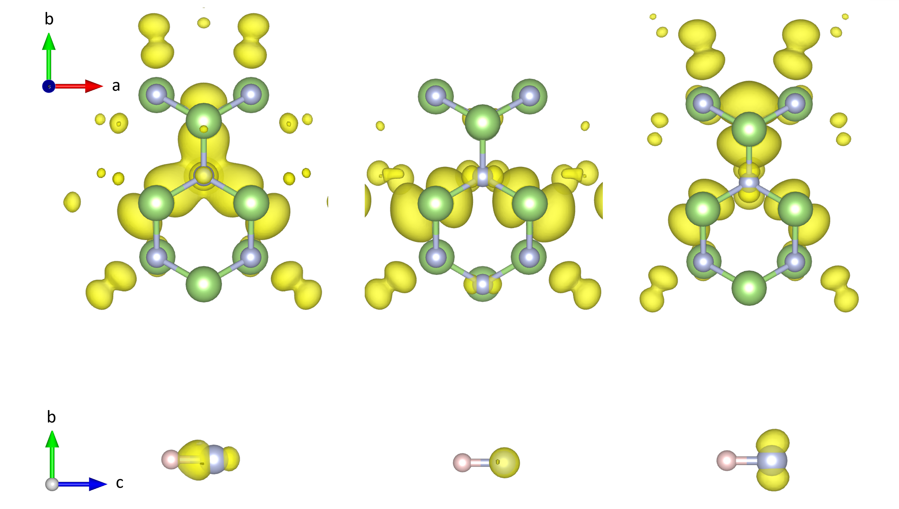
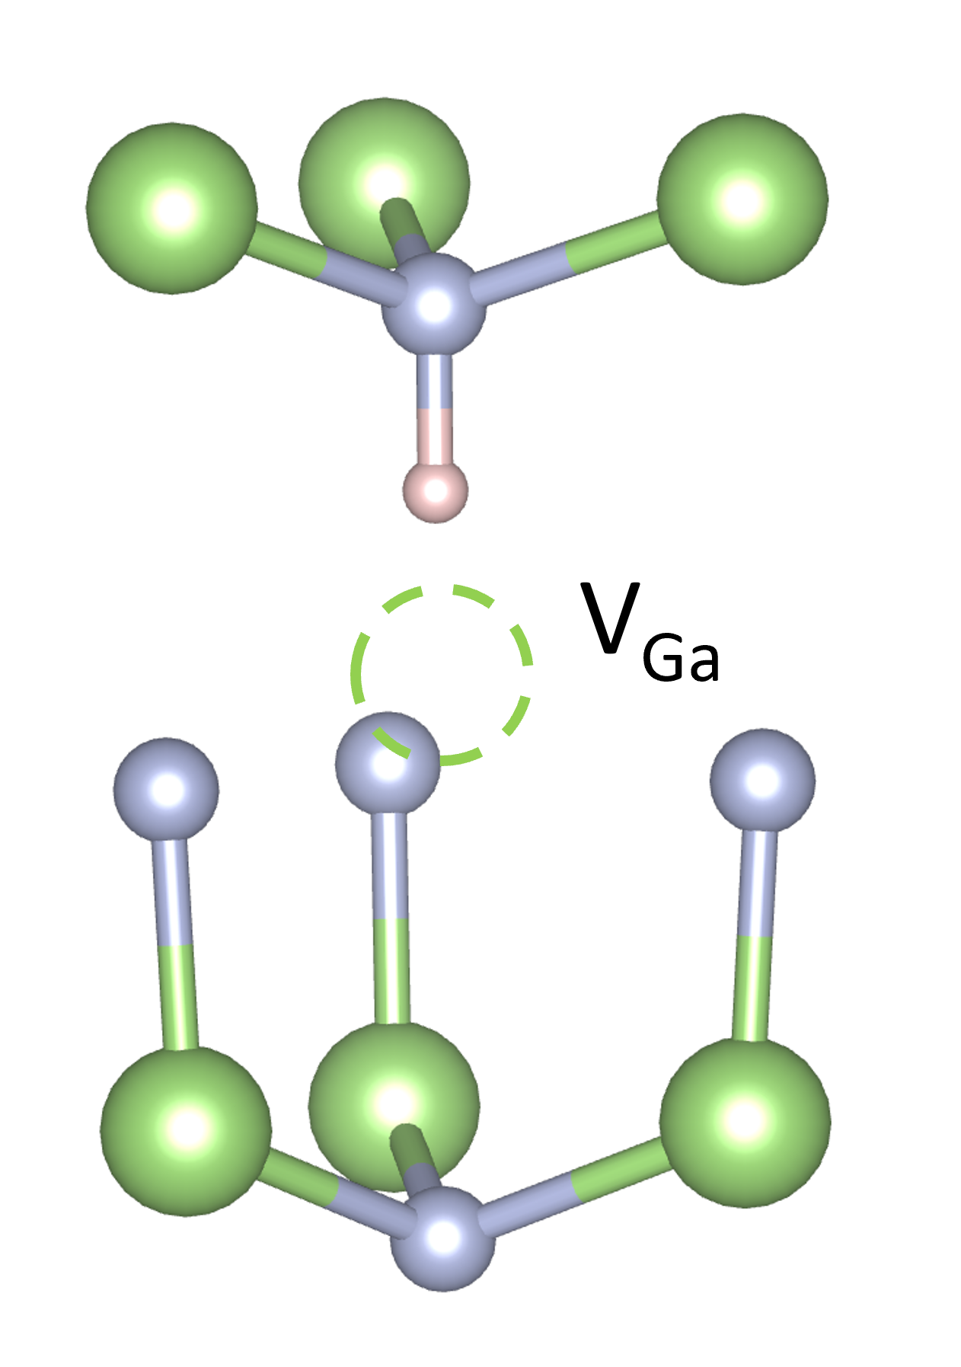

Proof-of-Concept Calculation

Slide 30
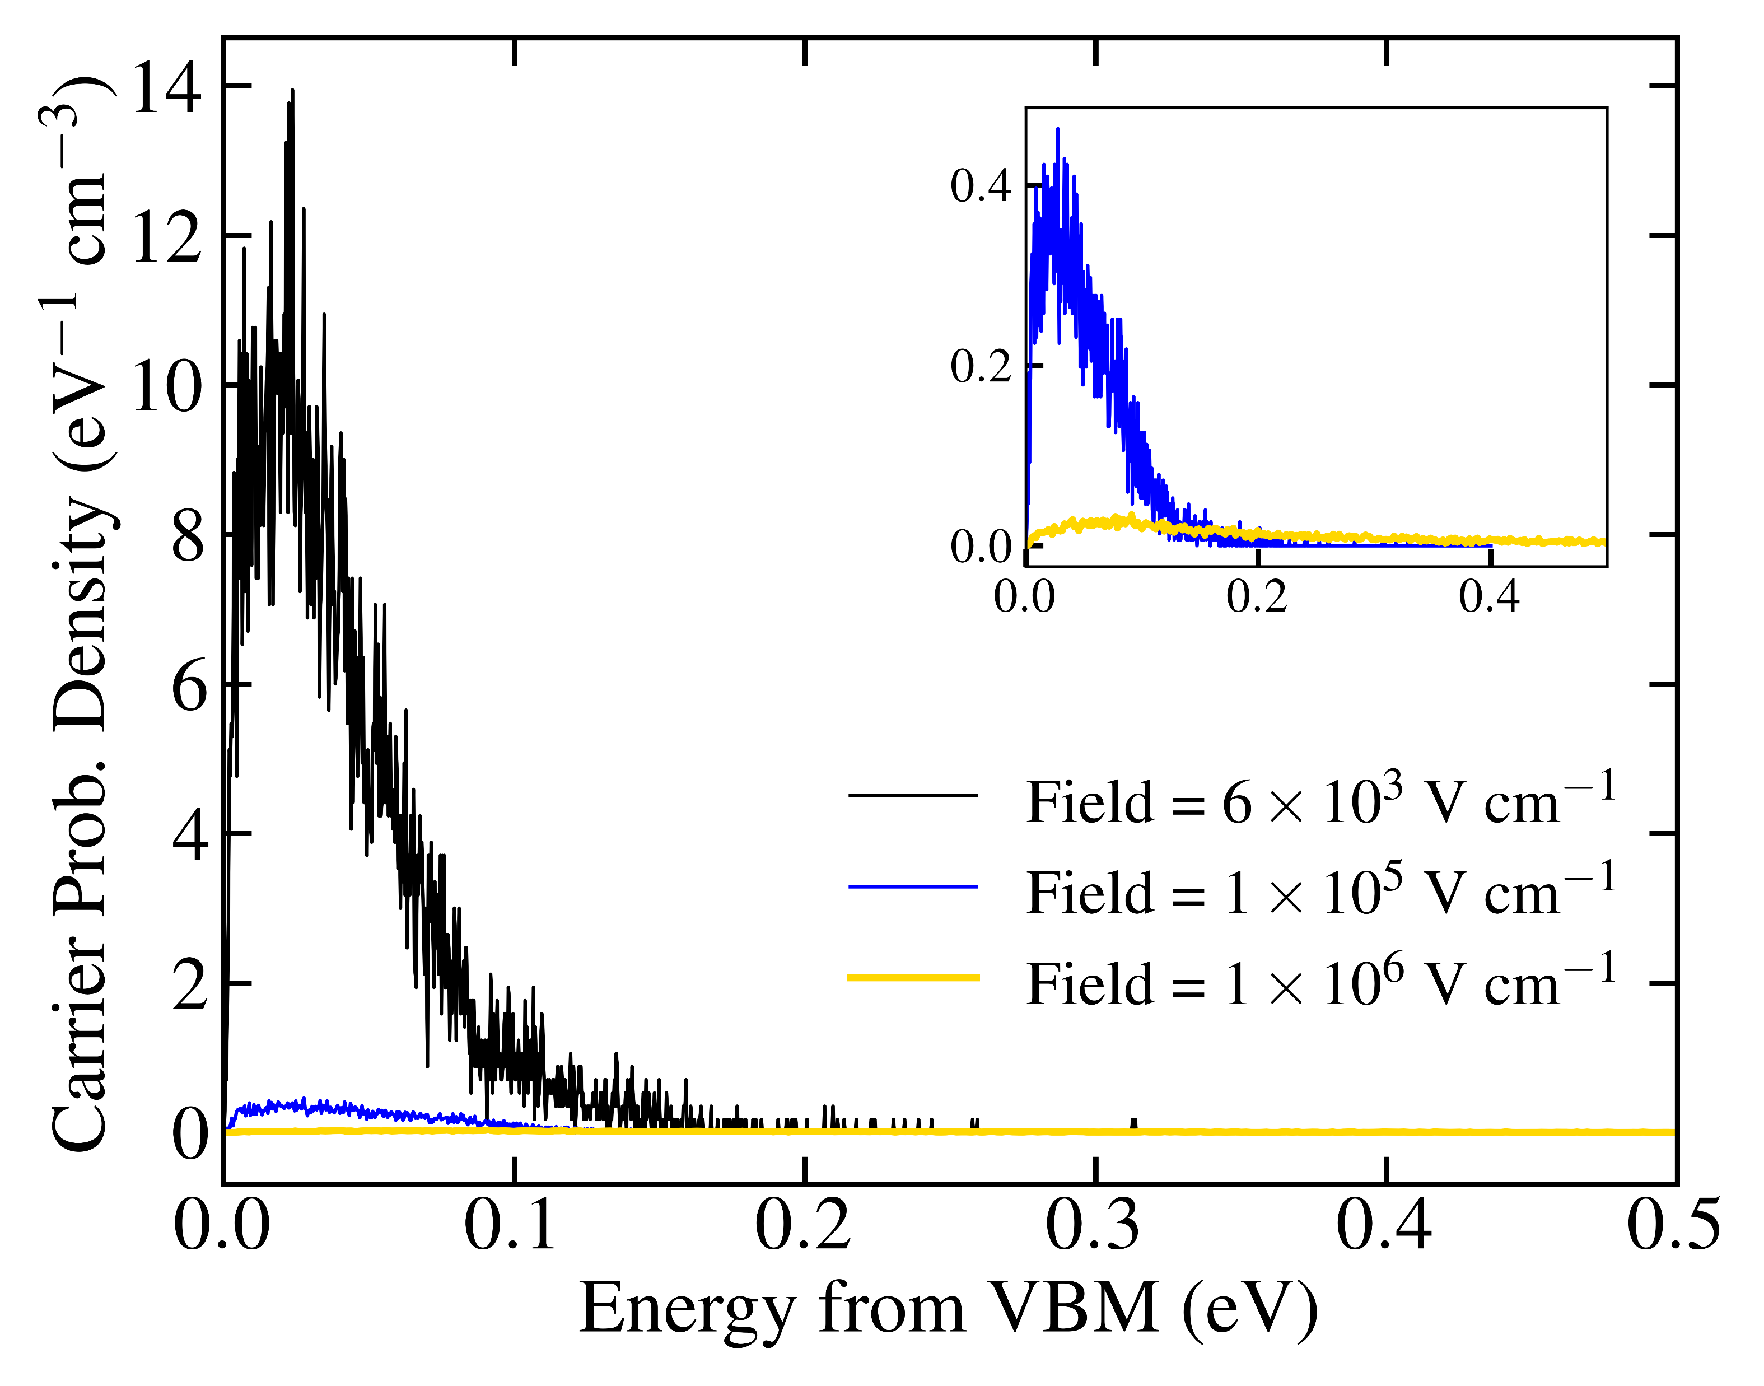
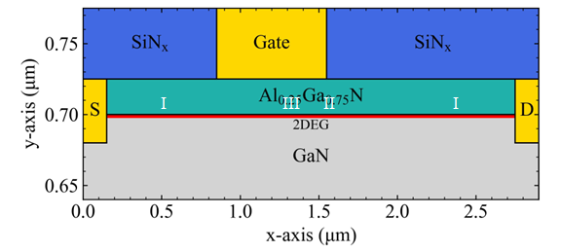
Device Specifications
I
III
II
I
Carrier densities and schematic from D. Nielsen and M. Fischetti, UT Dallas
Notes:
I = lowest field, highest density (black)
II = highest field (gold)
III = middle field (blue)
Field and carrier densities come from a HEMT device
Valence bands are then modeled to get probability distribution

Slide 31
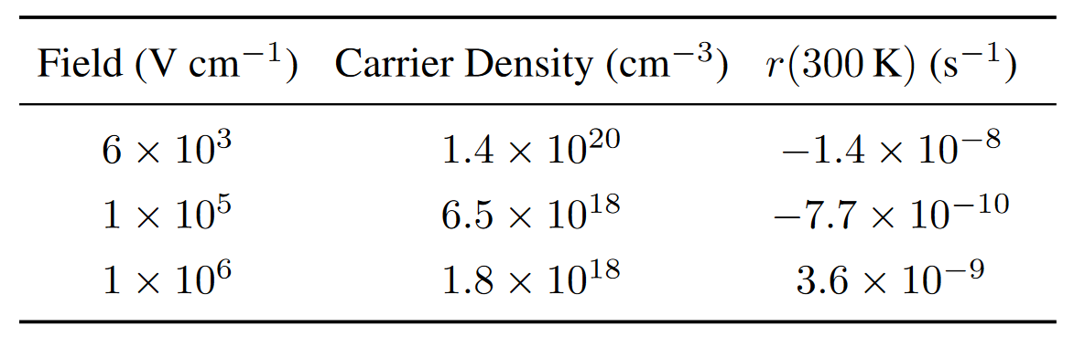
Rate of Release

Slide 32
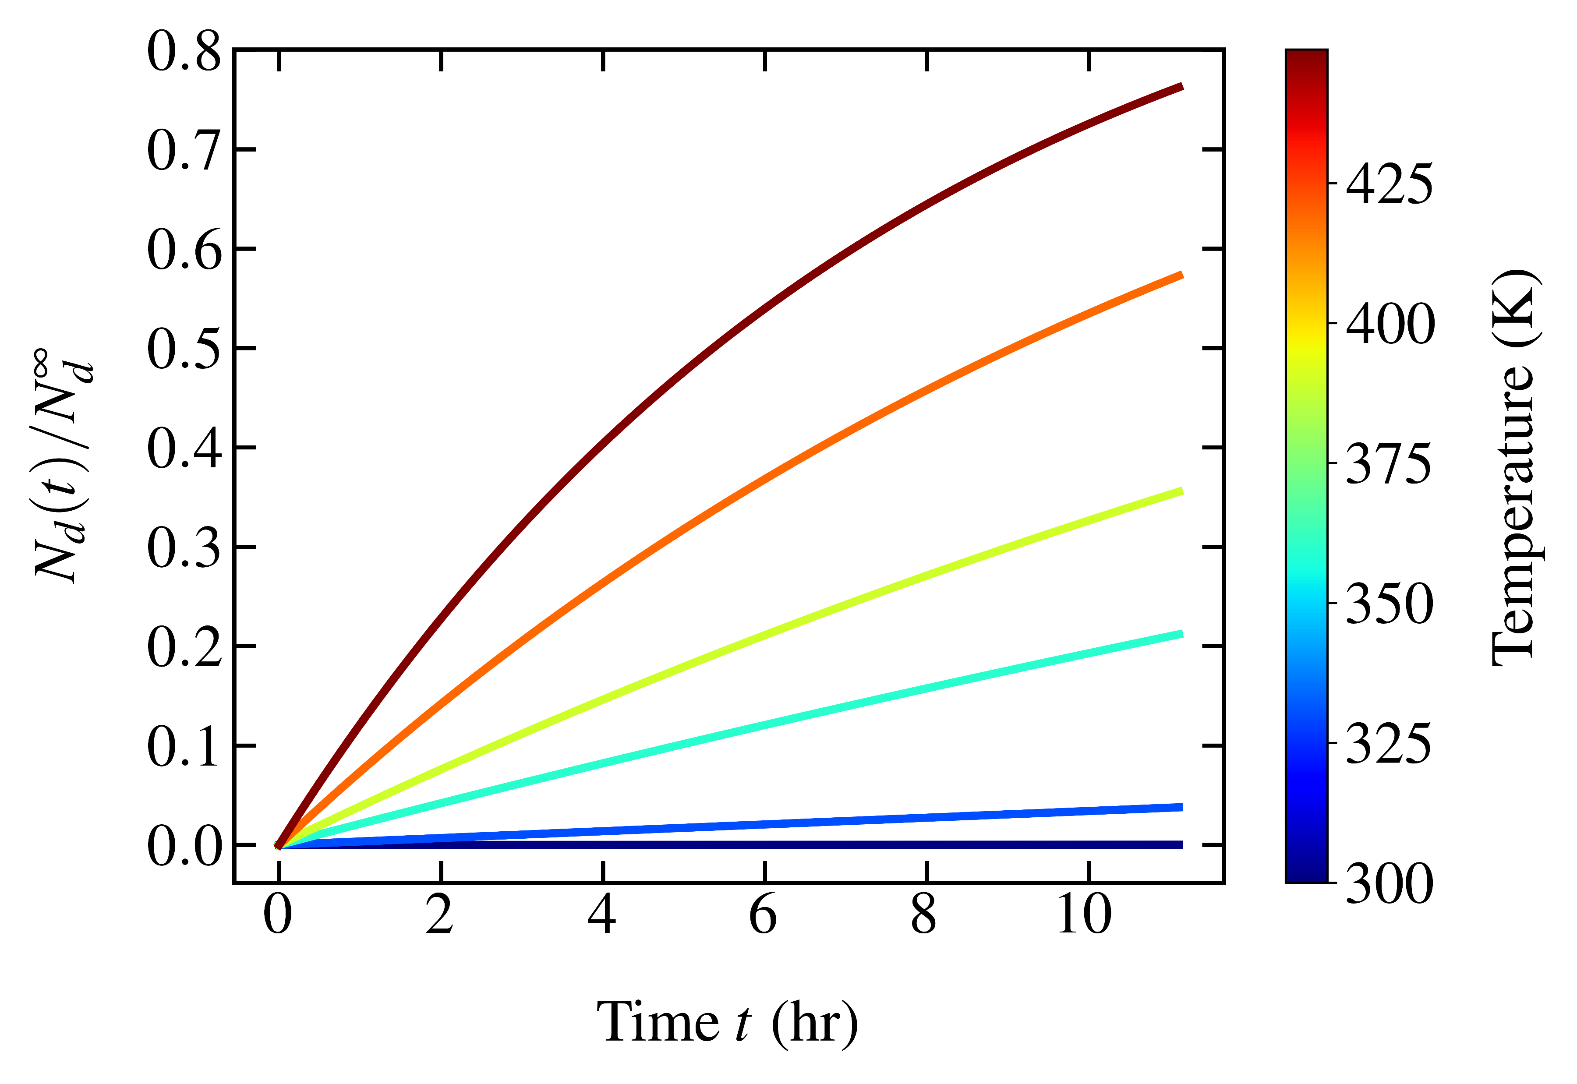
Fraction of Activated Defects Over Time

Slide 33

Fraction of Activated Defects Over Time
S. Mukherjee et al., IEE Trans. Elec. Dev. (2016)

Slide 34
(a)
(b)

Slide 35
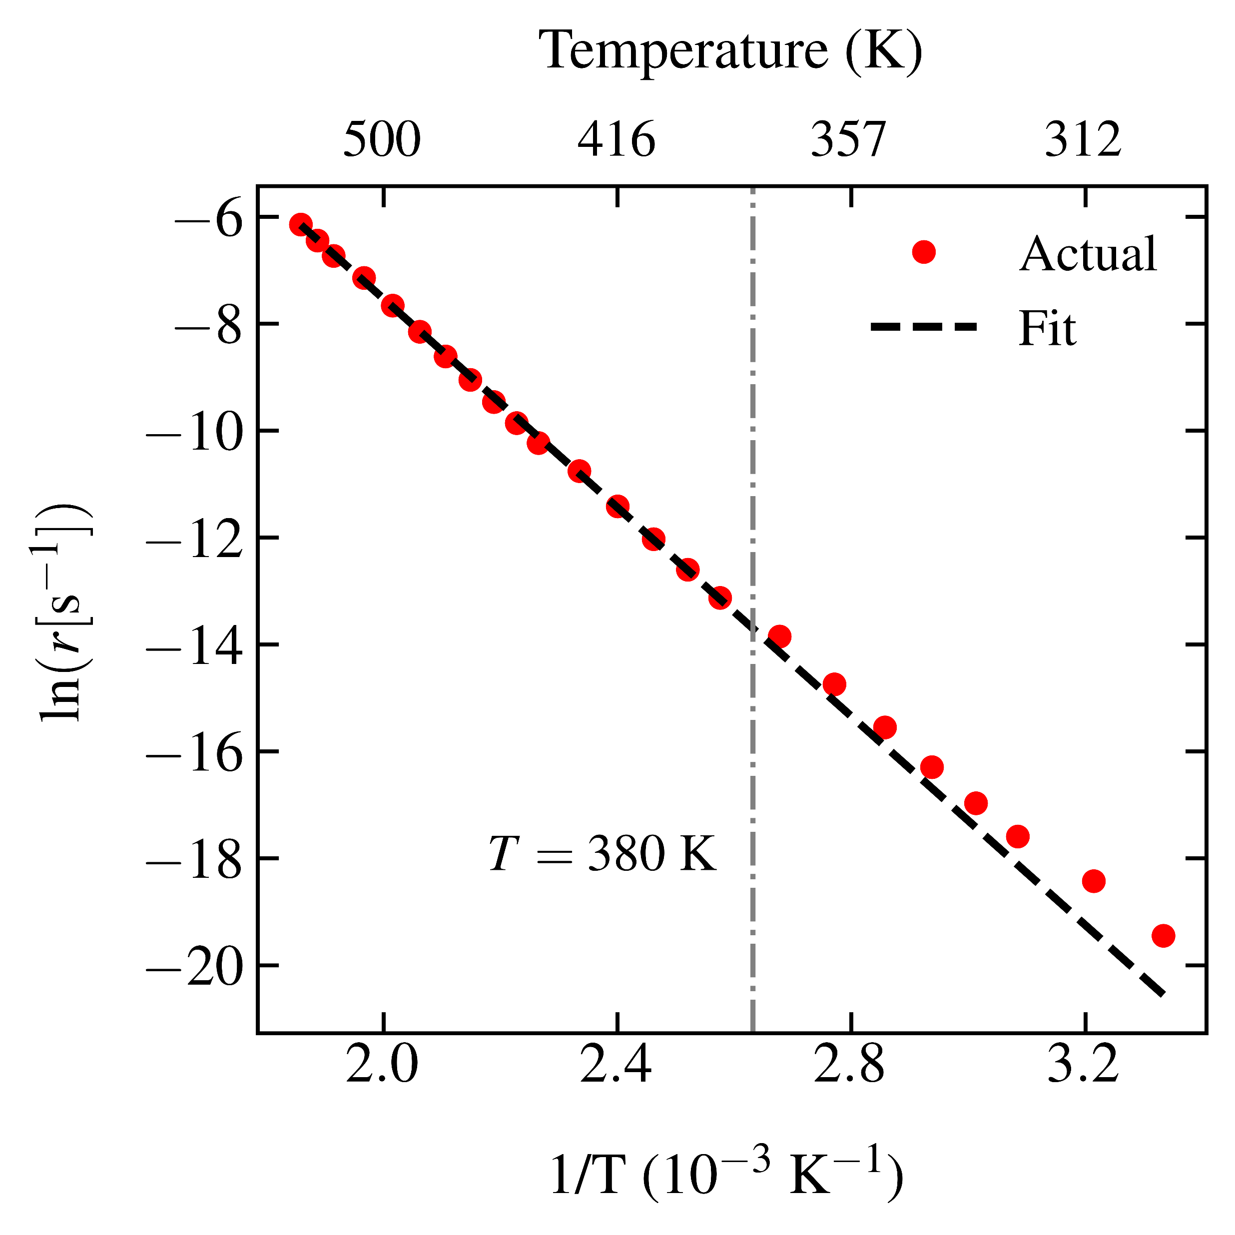
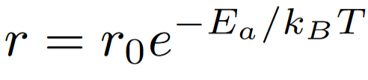
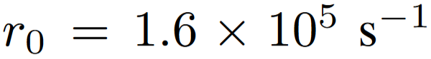
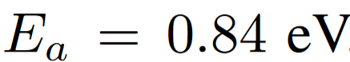
Arrhenius Plot
Best fit:

Slide 36
Code Transfer
Capture, scattering, and H release fully implemented
Two-day workshop held at Vanderbilt with Dallin, Andy, and Xiao
Future applications
Capture at various defects
Integration with Boltzmann code
Application to H release in real devices

